Slide 1
Rescue Operation
I need your help !
can you help me?
An Initiative by
Dr Rajasekhar Reddy
Ho
HOD of computer & Engineering
NBKRIST

Slide 2
"My loved one has been kidnapped, and I need to rescue them as quickly as possible. All I know is that they are being held in a bungalow with many rooms and the kidnappers will be absent in the afternoon. Time is of the essence because the longer my loved one is held captive, the more mentally disturbed they become."

Slide 3

Level 1:
Bungalow is highly secure with digital systems
Key changes for every opening
Number pad with numbers
[8, 6, 4, 3, 2, 1]
Hint: Arrange this in a right way ,I will give you way

Slide 4
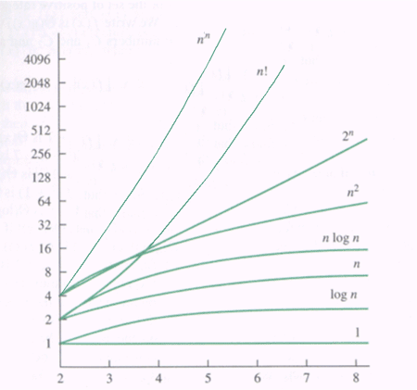

Slide 5
Level 2:
Digital board displays names and room numbers one at a time
Must click forward to find the desired name/room number
Clicking forward costs 1 second of time
Data: ["MA", "KA", "PL", "ER", "SS", ..., "GA"]

Slide 6
Level 3:
100 rooms numbered 1 to 100
Locked person in a specific room
Find person in minimum time
Search one room at a time?
Rooms=[1,2,3,4….,100]

Slide 7
Introduction to Python
High-level programming language
Simple and easy to learn
Interpreted language, no compilation needed
Large standard library
Widely used in data science and web development

Slide 8
Variables and DataTypes
Variables are containers for storing values
Data types include integers, floats, strings, booleans, and more
Dynamic typing allows variables to change data type
Variable names must follow certain rules (e.g. start with a letter, no spaces)
Use type() function to check variable data type

Slide 9
Naming Conventions in Python
Use descriptive variable names
Separate words in variable names with underscores (snake_case)
Use lowercase letters for variable names
Avoid using reserved keywords as variable names
Shouldn’t start with Numbers

Slide 10
Introduction to Operators
Arthimetic Operators +, -, *, /, % (modulus), and ** (exponentiation)
Comparison operators include ==, !=, <, >, <=, >=
Logical operators include and, or, and not, xor(^)

Slide 11
Mutability vs Immutability
Mutability refers to the ability of an object to change its value or state after its creation
Mutable
Lists,Dictionaries,Sets
Immutable
Strings,Tuples,Numbers (integers, floats, etc.)

Slide 12
Introduction to Lists
Lists store multiple values in a single variable and Dynamic Array .
Lists can contain different data types.
Lists are indexed, meaning items can be accessed by position.
Lists can be used in loops and other control structures.
Lists can be used in loops and other control structure

Slide 13
List Time Complexities
Creation: O(n) or O(1)
Accessing: O(1)
Searching: O(n)
Insertion: O(n)
Deletion: O(n) or O(1) with pop()

Slide 14
Lists Methods
.append(element) .insert(index,element)
.remove(element) .pop(index) or pop()
.count(element) .sort()

Slide 15
for loop syntax
if-else syntax: elif syntax:
if condition: if Condition:
code code
else: elif:
code code
else:
code

Slide 16
for loop syntax
for item in iterable:
for i in range(start, stop, step):
for i, item in enumerate(iterable):
for a, b in zip(iterable1, iterable2):

Slide 17
Given an array of integers nums which is sorted in ascending order, and an integer target, write a function to search target in nums. If target exists, then return its index. Otherwise, return -1
Input: [2, 5, 7, 8, 9],k=5
Output: 1
Time Complexity:O(n),O(logn)
Space Complexity:O(1),O(n)

Slide 18
Given an array of integers nums sorted in non-decreasing order, find the starting and ending position of a given target value. If target is not found in the array, return [-1, -1].
Input:[5,7,7,8,8,10] ,Target=8
Output: [2,3]
Time Complexity:O(n),O(logn)
Space Complexity:O(1)

Slide 19
Write a function that takes an array of integers and a target value, and returns the index of the first occurrence of the target value in the array. If the target value is not found, return -1.
Input: [2, 5, 7, 8, 9, 3],target = 16
Output: 2
Time Complexity:O(n),O(n^2)
Space Complexity:O(1),O(n)

Slide 20
Given an integer array nums, return true if any value appears at least twice in the array, and return false if every element is distinct.
Input: [2, 5, 7, 8,2]
Output: True
Time Complexity:O(n),O(n^2)
Space Complexity:O(1),O(n)

Slide 21
Given an array nums containing n distinct numbers in the range [0, n], return the only number in the range that is missing from the array.
Input:[1,2,3,5,6,7]
Output: 4
Time Complexity:O(n),O(n^2)
Space Complexity:O(1),O(n)

Slide 22
Given two binary numbers in the form of string and check whether two numbers can be same after rearranging 0’s and 1’s
Input: 101 and 011
Example:110,110,101,101
Output: True
Time Complexity:O(nlogn),O(n)
Space Complexity:O(1),O(n)

Slide 23
Given an integer array nums, return an array answer such that answer[i] is equal to the product of all the elements of nums except nums[i].
Input: [1,2,3,4]
Output: [24,12,8,6]
Time Complexity:O(n),O(n^2),O(nlogn)
Space Complexity:O(1),O(n)

Slide 24
convert the given decimal number into binary and then calculate the number of number of ones in even and odd places
Input: 5
Binary number:101
Output: [2,0]
Time Complexity:O(n)
Space Complexity:O(1)

Slide 25
Given an array of integers nums containing n + 1 integers where each integer is in the range [1, n] inclusive.
return the count of all integers
Input: [1,2,2,3]
Output: 1-1
2-1
3-1
Time Complexity:O(n)
Space Complexity:O(1)

Slide 26
Given an integer array nums and an integer k, return the kth largest element in the array.
Input: [2, 5, 7, 8, 9, 3],k=2
Output: 8
Time Complexity:O(n),O(nlogn)
Space Complexity:O(1),O(n)

